Slide 1
Welcome Back to School Night
2014-2015
Please fill-out the questionnaire on your child’s desk.

Slide 2
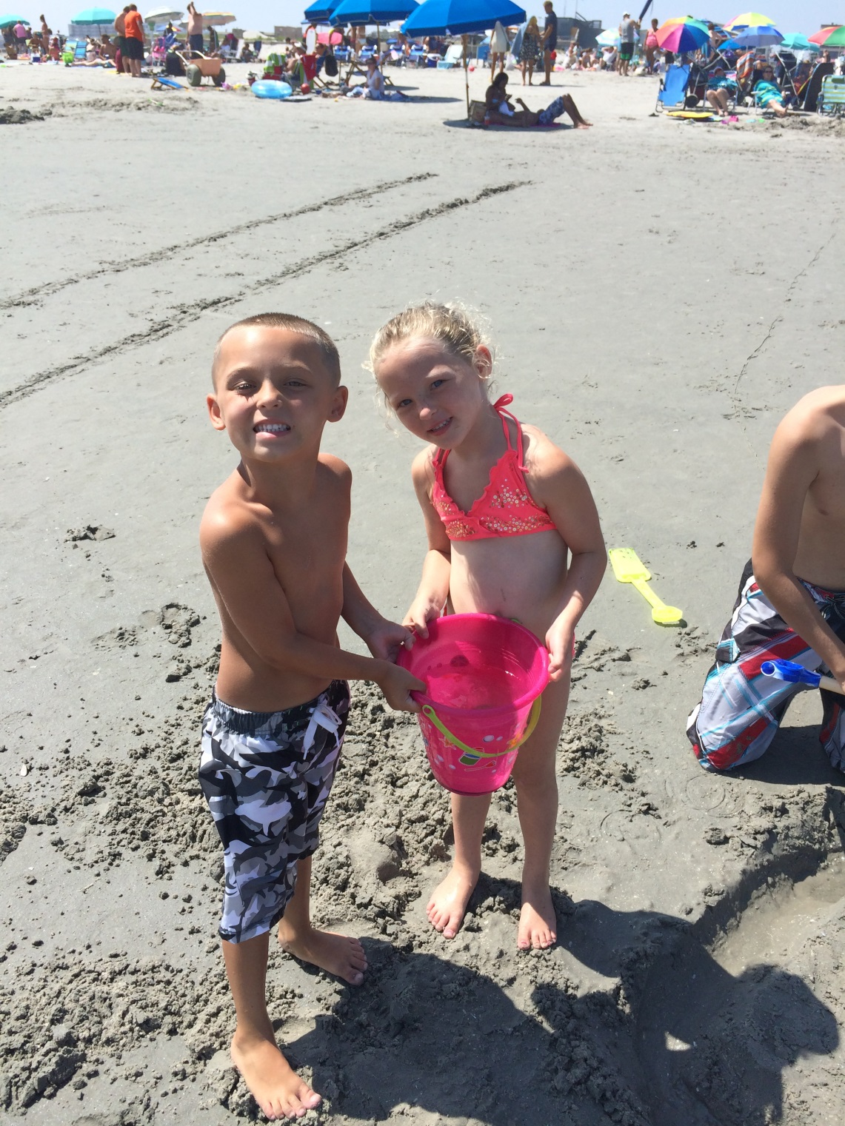
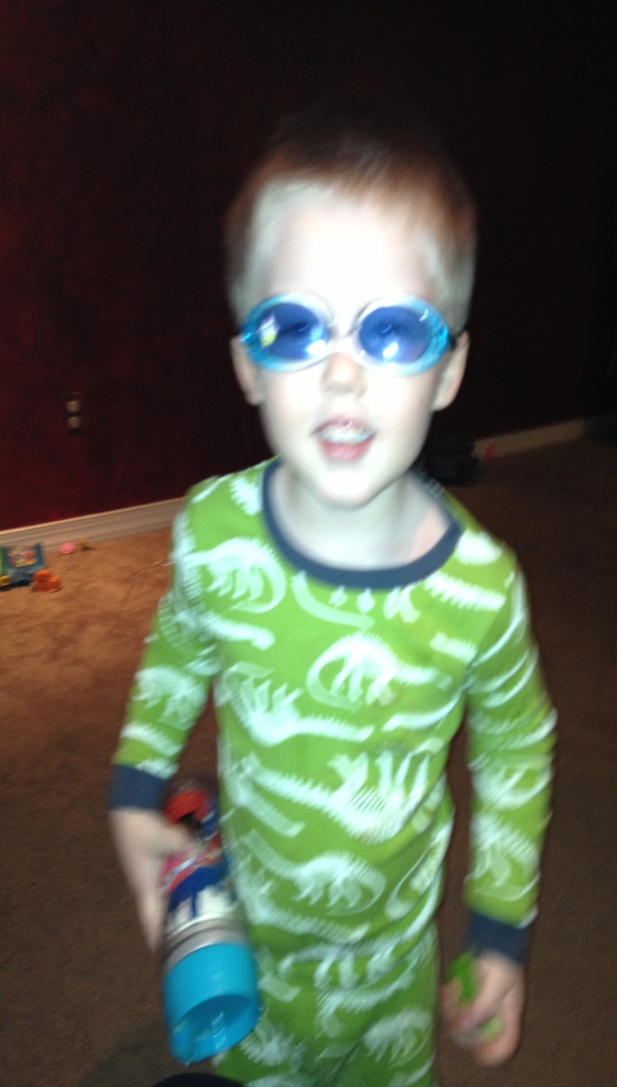

Slide 3
Language Arts Curriculum
How will it look as homework?
Spelling/Words Their Way: List on Monday and test on Friday.
Vocabulary: Matches Common Core
Comprehension: DRA (fluency and comp.)
Writing/Grammar: New Writing Program – Schoolwide
Reading Incentive: Monthly (Two books per month. One I choose, the other free choice) A task / job after each book. They should be reading on their independent level.

Slide 4
Specials
Day 1: No Special
Day 2: Music
Day 3: Gym & Computers
Day 4: Library
Day 5: Art
Chorus on Day 2

Slide 5
Science
Too Good for Violence – Sept. & Oct. introducing mediation
Check yourself quiz
Sun, Moon, and Planets
Magnetism and Electricity-
Water Kit
Too Good For Drugs
Science Fair usually in March
PSSA Prep questions
Science PSSA- April 27

Slide 6
Mathematics Curriculum
How will it look as homework?
Math In Focus: Nightly homework
Math fluency: See handouts for rates.
Math in Focus: I’m asking for 30 minutes a week. If you do not have a computer with internet access, the children can work on DreamBox during lunch recess.
Challenge 24: Math game/competition in May

Slide 7
Social Studies Curriculum
Social Studies Alive: Focuses on the geography of the five regions of the U.S.A.
Pennsylvania: Focuses on early settlement and history of PA as well as the State’s geography.

Slide 8
Summary of Homework
Monday: Spelling Worksheet (2 sided)
Tuesday: Reading Comprehension (2 sided)
Wednesday: Vocabulary (2 sided)
Thursday: Spelling worksheet (2 sided)
Study for spelling test

Slide 9
Summary of Homework cont.
Mathematics: Homework given every night.
Daily
  Independent reading (2 books monthly)
  Math in Focus (approximately 30 minutes a week)
  Math Fact Fluency practice

Slide 10
Housekeeping
Absences: Send in a note when your child returns to school. The office marks your child unlawful if a note is not sent to school.
Questions/Concerns: Jot me a note or an email, rfisher@neshaminy.k12.pa.us
Snack break: Everyday after Special…a healthy snack.
Art Smock

Slide 11
Thank you for coming!
I am looking forward to a challenging, productive, and fun year.
Your attendance “Mint” a lot to me!

Slide 12
Mathematics Curriculum
How will it look as homework?
Math In Focus: Nightly homework
Math fluency: See handouts for rates.
Math in Focus: I’m asking for 30 minutes a week. If you do not have a computer with internet access, the children can work on DreamBox during lunch recess.
Challenge 24: Math game/competition in May

Slide 13
